Slide 1
Google File System

Slide 2
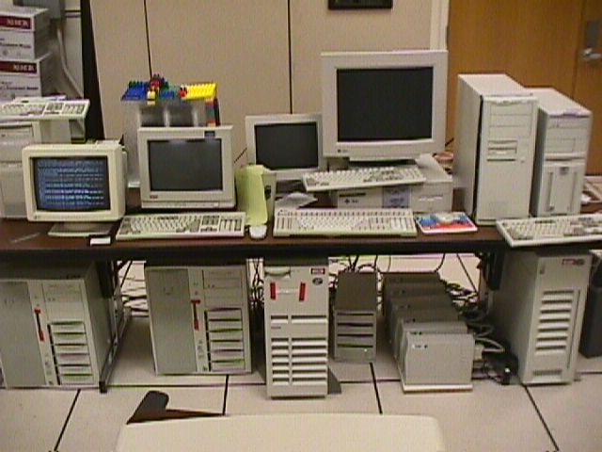
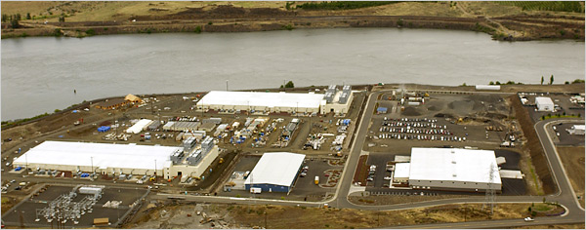
Google Disk Farm
Early days…
…today

Slide 3
Design
Design factors
  Failures are common (built from inexpensive commodity components)
  Files
    large (multi-GB)
    mutation principally via appending new data
    low-overhead atomicity essential
  Co-design applications and file system API
  Sustained bandwidth more critical than low latency
File structure
  Divided into 64 MB chunks
  Chunk identified by 64-bit handle
  Chunks replicated (default 3 replicas)
  Chunks divided into 64KB blocks
  Each block has a 32-bit checksum
chunk
file
…
blocks

Slide 4
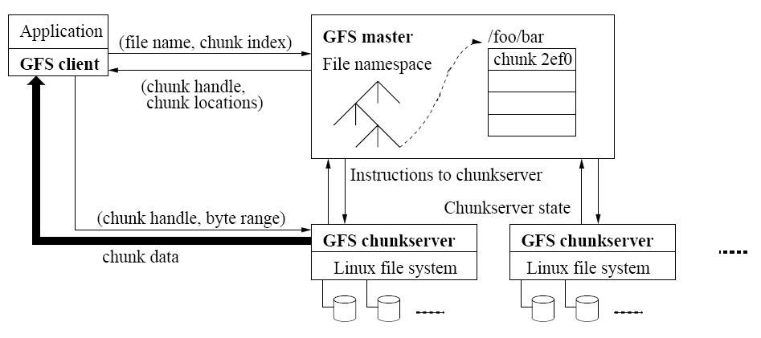
Architecture
metadata
data
Master
  Manages namespace/metadata
  Manages chunk creation, replication, placement
  Performs snapshot operation to create duplicate of file or directory tree
  Performs checkpointing and logging of changes to metadata
Chunkservers
  Stores chunk data and checksum for each block
  On startup/failure recovery, reports chunks to master
  Periodically reports sub-set of chunks to master (to detect no longer needed chunks)

Slide 5
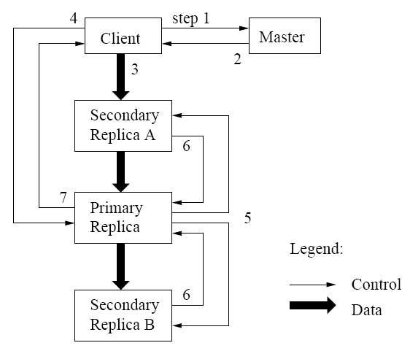
Mutation operations
Primary replica
  Holds lease assigned by master (60 sec. default)
  Assigns serial order for all mutation operations
  performed on replicas
Write operation
  1-2: client obtains replica locations and identity of
  primary replica
  3: client pushes data to replicas (stored in LRU
  buffer by chunk servers holding replicas)
  4: client issues update request to primary
  5: primary forwards/performs write request
  6: primary receives replies from replica
  7: primary replies to client
Record append operation
  Performed atomically (one byte sequence)
  At-least-once semantics
  Append location chosen by GFS and returned to client
  Extension to step 5:
    If record fits in current chunk: write record and tell replicas the offset
    If record exceeds chunk: pad the chunk, reply to client to use next chunk

Slide 6
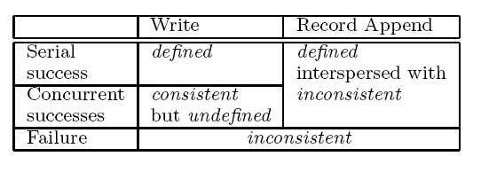
Consistency Guarantees
primary
primary
primary
replica
replica
replica
defined
consistent
inconsistent
Write
  Concurrent writes may be consistent but undefined
  Write operations that are large or cross chunk boundaries
  are subdivided by client into individual writes
  Concurrent writes may become interleaved
Record append
  Atomically, at-least-once semantics
  Client retries failed operation
  After successful retry, replicas are defined
  in region of append but may have
  intervening undefined regions
Application safeguards
  Use record append rather than write
  Insert checksums in record headers to detect fragments
  Insert sequence numbers to detect duplicates

Slide 7
Metadata management
pathname
lock
chunk list
Logical structure
/home
read
Chunk4400488,…
/save
Chunk8ffe07783,…
/home/user/foo
write
Chunk6254ee0,…
/home/user
read
Chunk88f703,…
Namespace
  Logically a mapping from pathname to chunk list
  Allows concurrent file creation in same directory
  Read/write locks prevent conflicting operations
  File deletion by renaming to a hidden name; removed during regular scan
Operation log
  Historical record of metadata changes
  Kept on multiple remote machines
  Checkpoint created when log exceeds threshold
  When checkpointing, switch to new log and create checkpoint in separate thread
  Recovery made from most recent checkpoint and subsequent log
Snapshot
  Revokes leases on chunks in file/directory
  Log operation
  Duplicate metadata (not the chunks!) for the source
  On first client write to chunk:
    Required for client to gain access to chunk
    Reference count > 1 indicates a duplicated chunk
    Create a new chunk and update chunk list for duplicate

Slide 8
Chunk/replica management
Placement
  On chunkservers with below-average disk space utilization
  Limit number of “recent” creations on a chunkserver (since access traffic will follow)
  Spread replicas across racks (for reliability)
Reclamation
  Chunk become garbage when file of which they are a part is deleted
  Lazy strategy (garbage college) is used since no attempt is made to reclaim chunks at time of deletion
  In periodic “HeartBeat” message chunkserver reports to the master a subset of its current chunks
  Master identifies which reported chunks are no longer accessible (i.e., are garbage)
  Chunkserver reclaims garbage chunks
Stale replica detection
  Master assigns a version number to each chunk/replica
  Version number incremented each time a lease is granted
  Replicas on failed chunkservers will not have the current version number
  Stale replicas removed as part of garbage collection

Slide 9
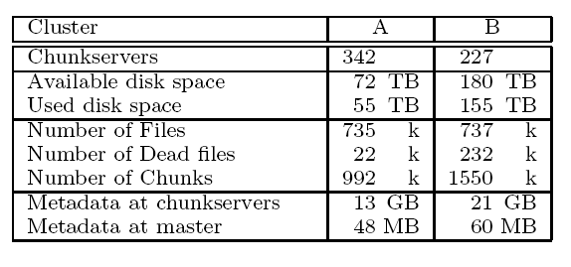
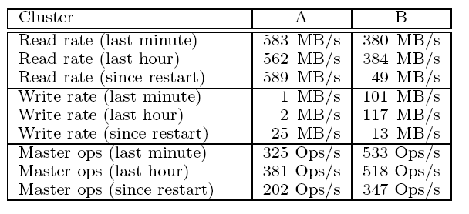
Performance

